Slide 1
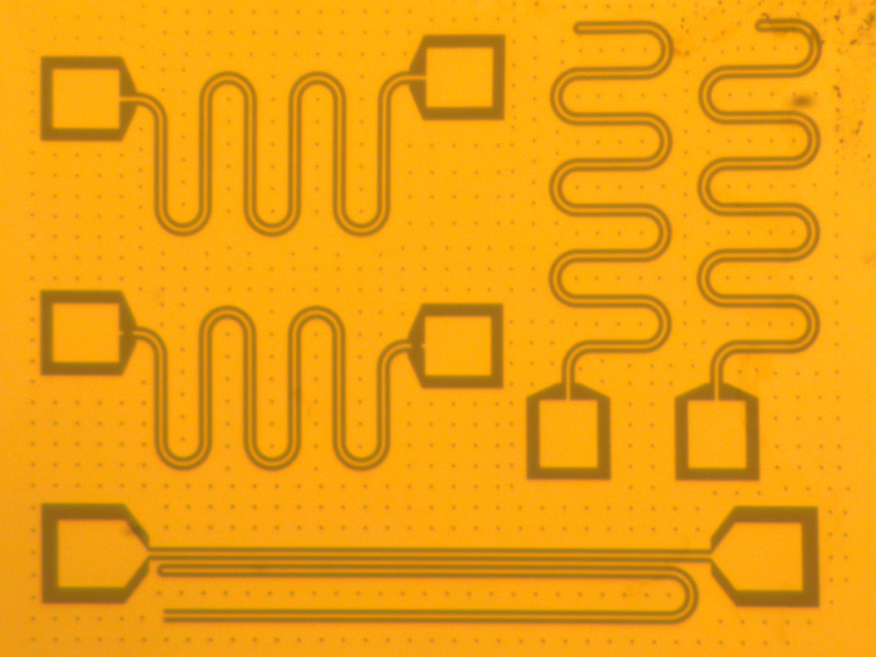
Superconducting Nanoelectronics with Perovskite Oxides
By Sushant Padhye
Research Advisors: Dr. Evgeny Mikheev,
Dr. Marc Cahay
Physics: Design and fabrication, Electrical device testing, and Python programming to communicate with instruments
ECE: Cleanroom Certification, Device Simulation

Slide 2
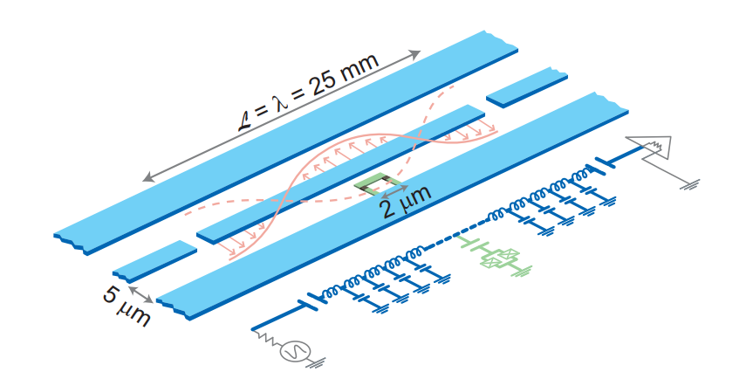
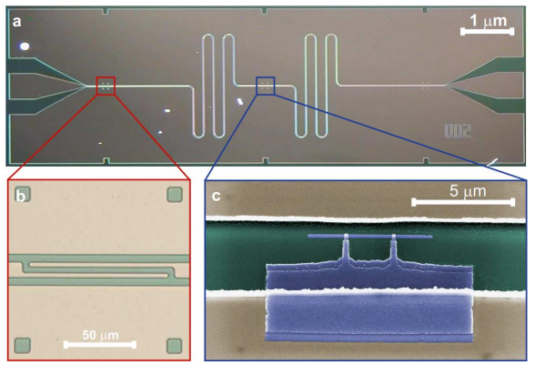
Big Picture
A
A
Side-view
• Patterned Nb -> Resonator Meander for Qubit’s Read-out
• Al junctions -> Qubit
Top-view
A: Resonators (Transmission Geometry)
* David Schuster PhD thesis, “Circuit Quantum Electrodynamics”, 2007
https://rsl.yale.edu/sites/default/files/files/RSL_Theses/SchusterThesis.pdf

Slide 3
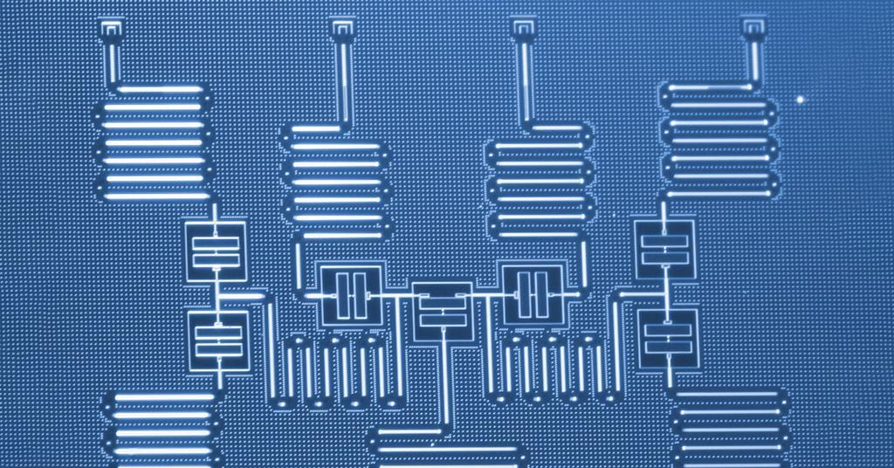
Big Picture
Resonators
Capacitor (Nb)
Josephson Junction
IBM’s 5 Qubit Processor
Currently used:
Silicon, Sapphire -> Insulating Substrates
Nb, Al -> Superconductors
New Material:
SrTiO₃ -> Can be both insulator and superconductor

Slide 4
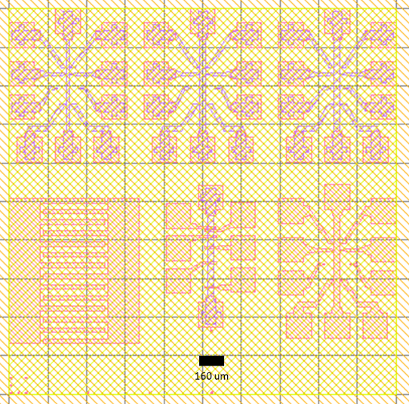
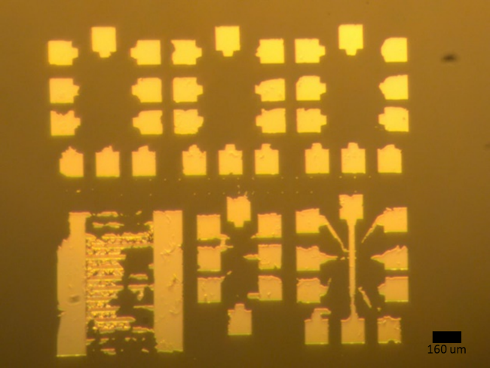
SrTiO₃ Crystal Chips
First CAD design
First device attempt
1: Hall bars
2: Contact resistance test structure (“TLM”)
3: Planar capacitor
1
1
1
1
2
3

Slide 5
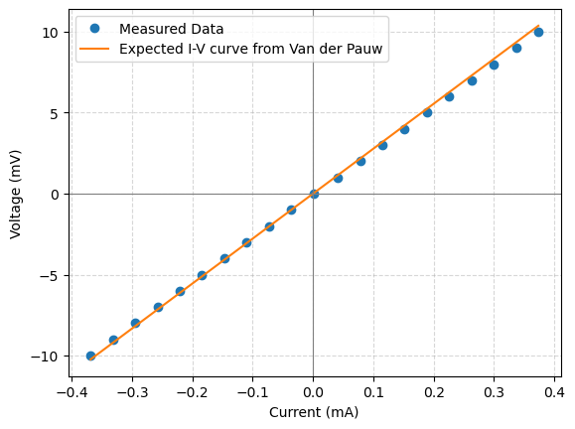
SrTiO₃ Crystal Chips
Zoomed-in view of the Hall Bar
I-V Curves for 2 terminal measurements
SRC
GND

Slide 6
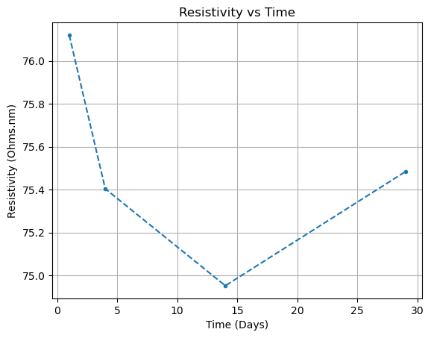
Al Thin Film on SrTiO3
Testing stability over time
Unpatterned “witness” chip
No meaningful change over several weeks

Slide 7
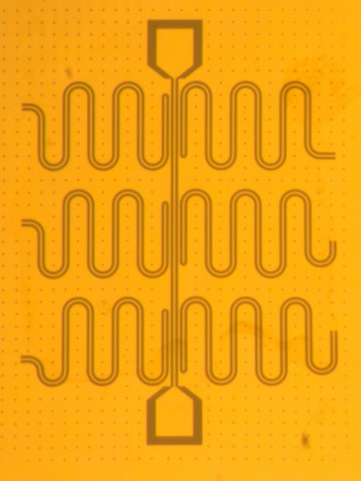
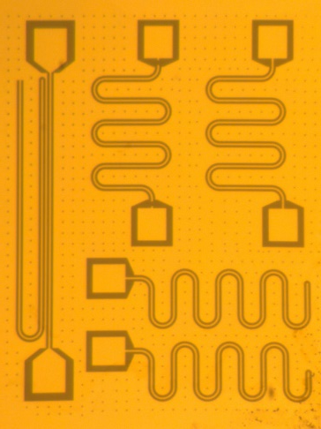
Nb Thin Film Chips (On SrTiO₃)
Resonators (Chip 3):
1
2
A
B
1: 6 hanger geometry resonators
2:
A: Large Hanger
B: 2 transmission C: 2 reflection resonators
C

Slide 8
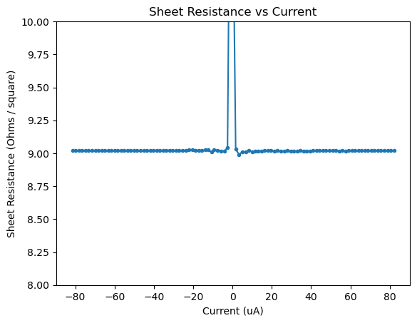
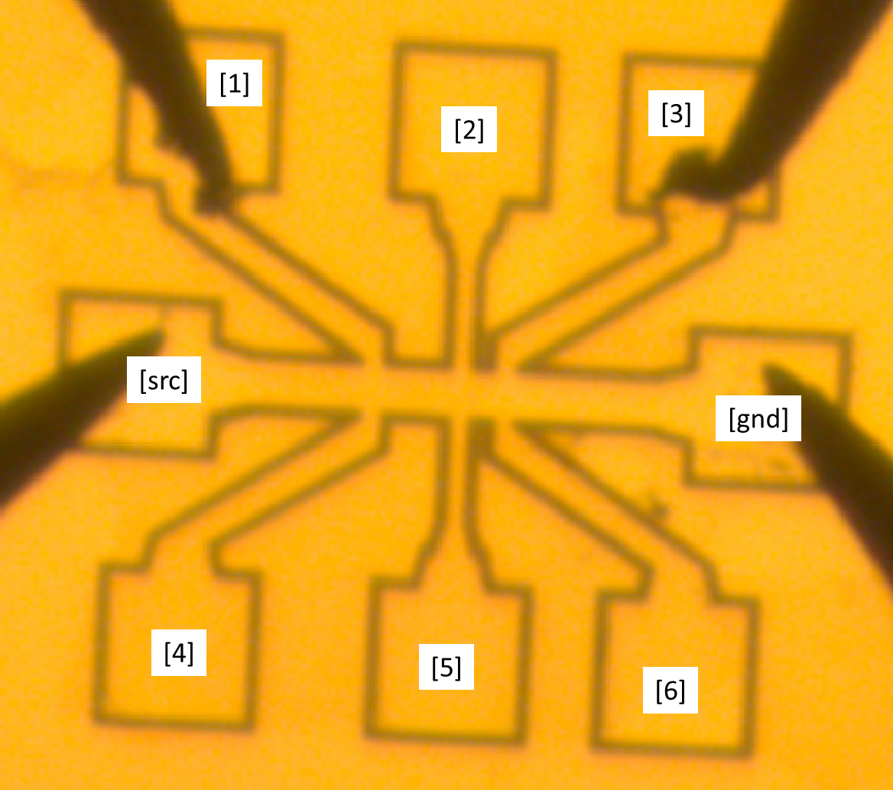
Nb Thin Film Chips (On Sapphire)
Sheet resistance data from Hall Bars:
Chip 2

Slide 9
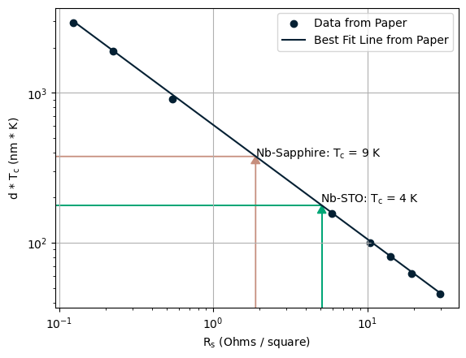
Nb Thin Film Chips
Devised a model :
Predict
Critical temperature (T_{c})
Using
Sheet resistance at room temperature (R_{s})
Film thickness (d)
* Y. Ivry, C-S. Kim et al, “Universal scaling of the critical temperature for thin films near the superconducting-to-insulating transition”. Phys. Rev. B, vol. 90, issue. 21, p 214515, Dec. 2014. (Also see Supplemental Material) https://journals.aps.org/prb/abstract/10.1103/PhysRevB.90.214515

Slide 10
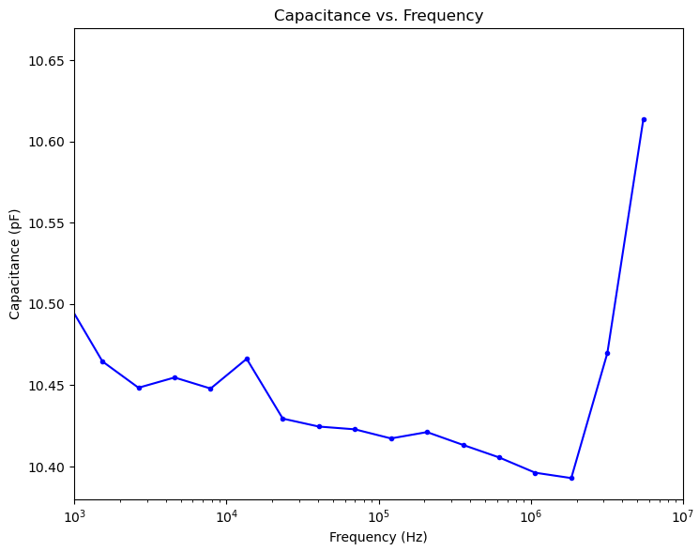
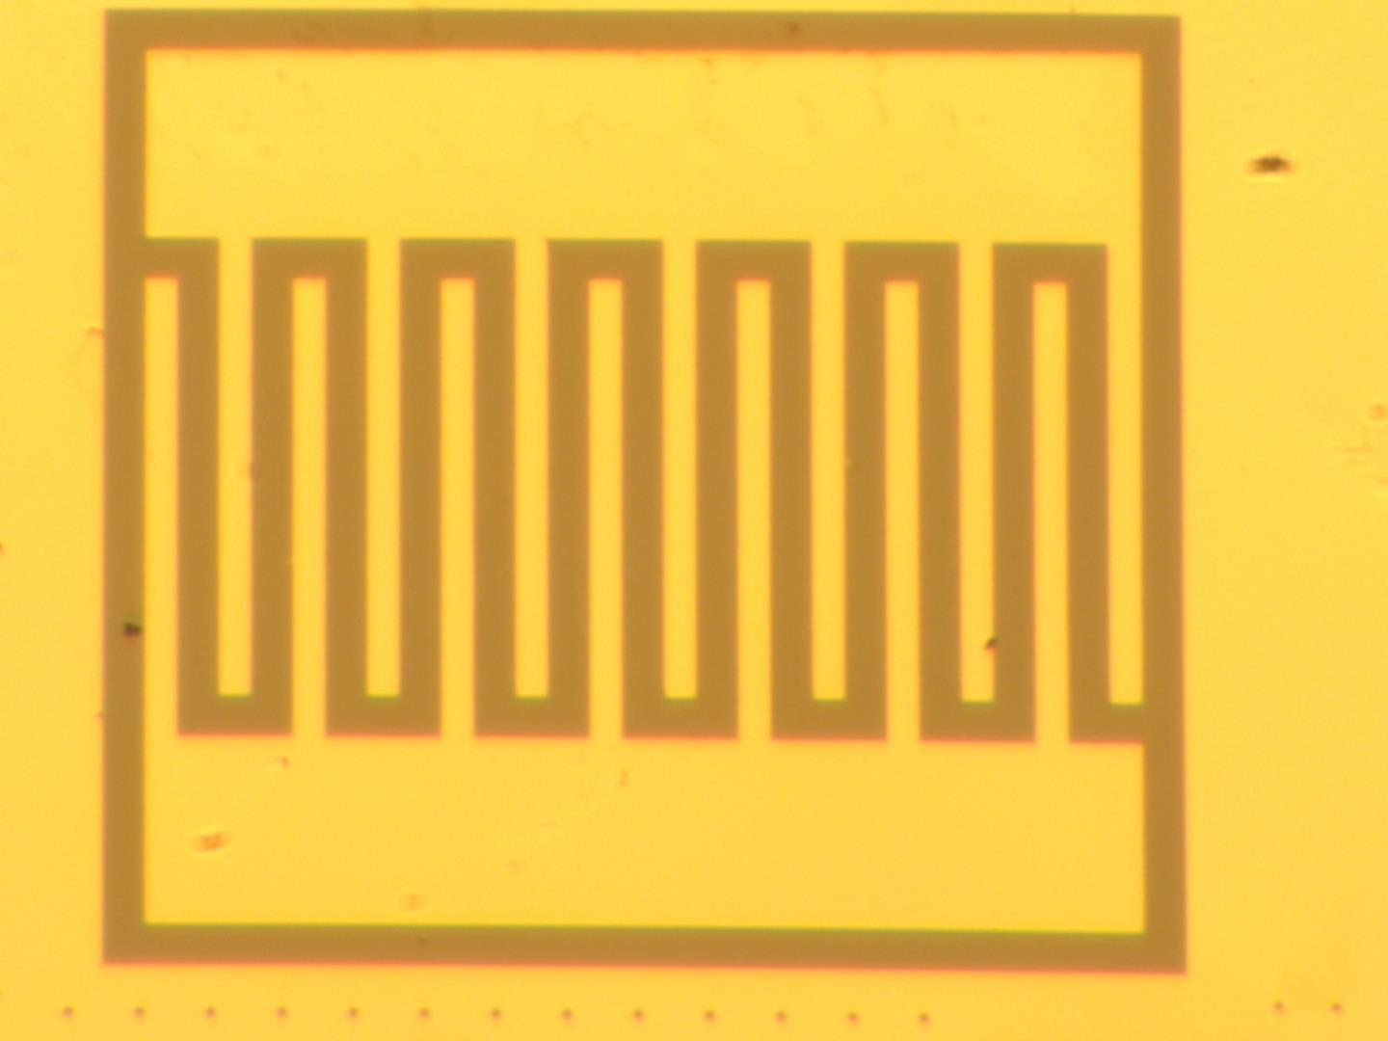
Nb Thin Film Chips (On SrTiO₃)
Capacitance data from IDC:
Quality Factor ≈ 3000 at optimal frequency (1-10 kHz)
Chip 3
IDC model calculation predicted ≈ 8 pF at SrTiO₃ ’s room temperature dielectric constant (350)
SRC
GND
* Bareesha R S et al, “Design and Optimization of Interdigital Capacitor”, 2018
https://ijret.org/volumes/2016v05/i33/IJRET20160533016.pdf

Slide 11
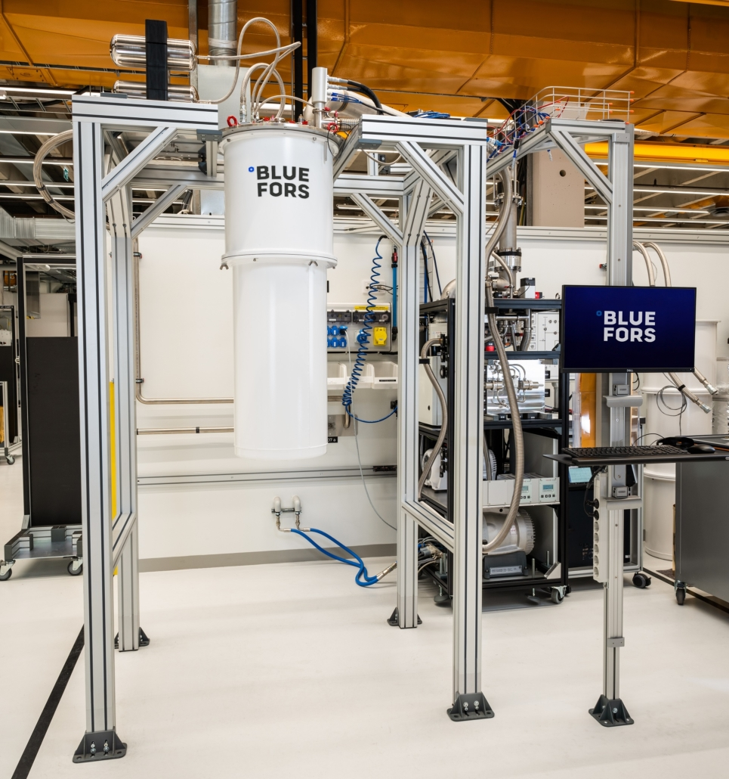
Conclusion
Things I learned:
Design, Fabrication and Testing of Devices
Automating pattern designs with code
Device Simulation (Ongoing)
Lab Setup
Questions?

